Slide 1
Graph matching network for malware detection
B04902103 蔡昀達
R07922055 李承軒
B06902006 王俊翔

Slide 2
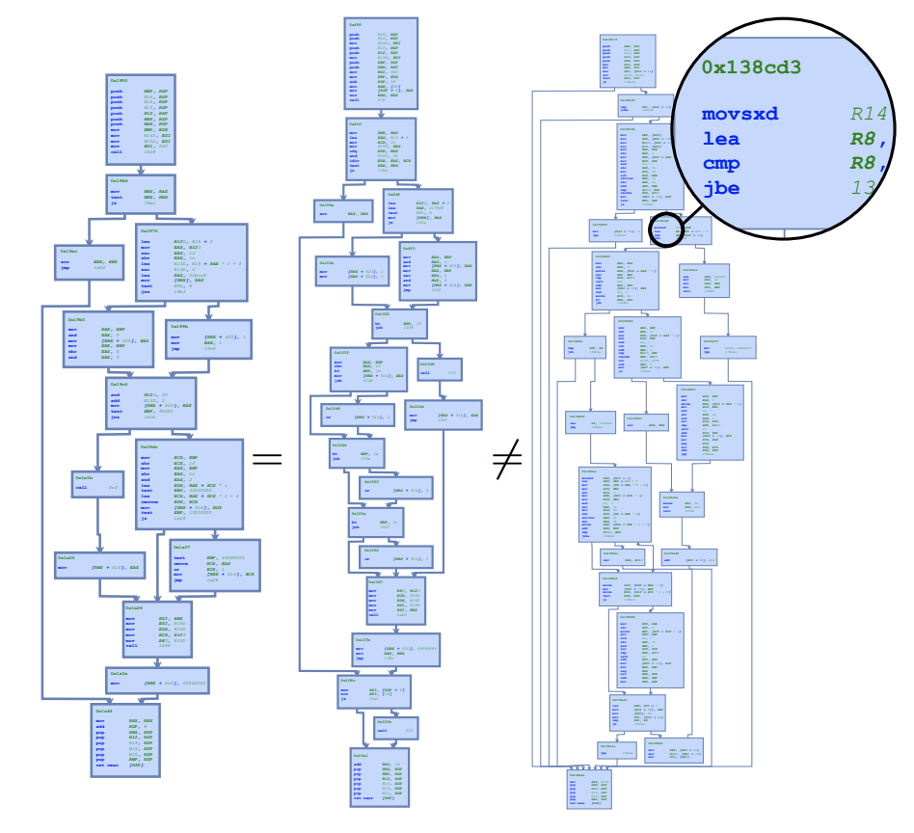
Outline
PE File Overview
Static malware analysis
Malware Dataset
Baseline models
Graph models
Evaluation
Limitation
Future work
Demo
Reference

Slide 3
PE File format - Overview
Portable executable is the standard binary file format in windows executables
.exe Executable program
.dll Dynamic Link Library
.sys Kernel driver
.acm Audio Compression Manager Driver
.ax DirectShow Filter
.cpl Windows Control Panel Item
.drv Device Driver
.efi Extensible Firmware Interface
.mui Multilingual User Interface
.ocx ActiveX Control
.scr Windows Screensaver File
.tsp Digital TV DVR Recording

Slide 4
PE File Format - header & section
Header tell the OS how to interpret the PE file
Type of PE file
Begin memory location (Entry Point)
Section memory arrangment (Section headers)
DLL dependencies (Imports)
PE file expose to other applications (Exports)
Sections store the PE file content
.text: This contains the executable code.
.rdata: This sections holds read only globally accessible data.
.data: Stores global data accessed through the program.
.rsrc: This sections stores resources needed by the executable.

Slide 5
Pe File Format - Optional header
The PE Optional header is used to store NT-specific attributes.
ImageBase
Prefered base memory address
Metadata
DLLCharacteristics: Security-related linker options
ASLR
DEP
SAFESEH
CFG
Subsystem
Supported NT version

Slide 6
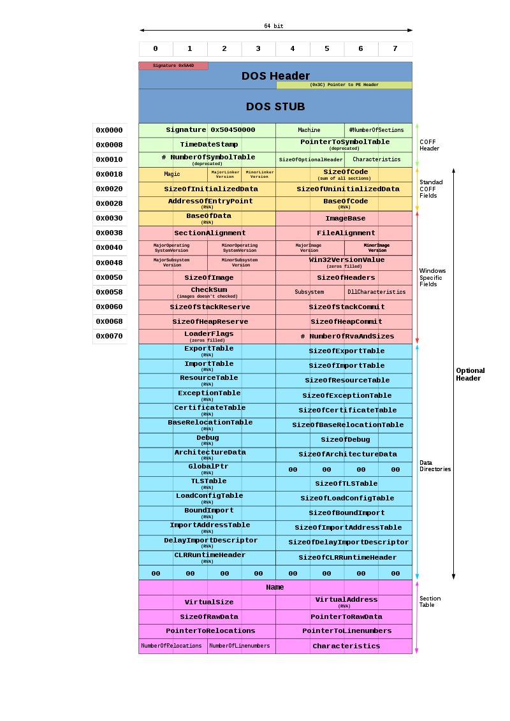

Slide 7
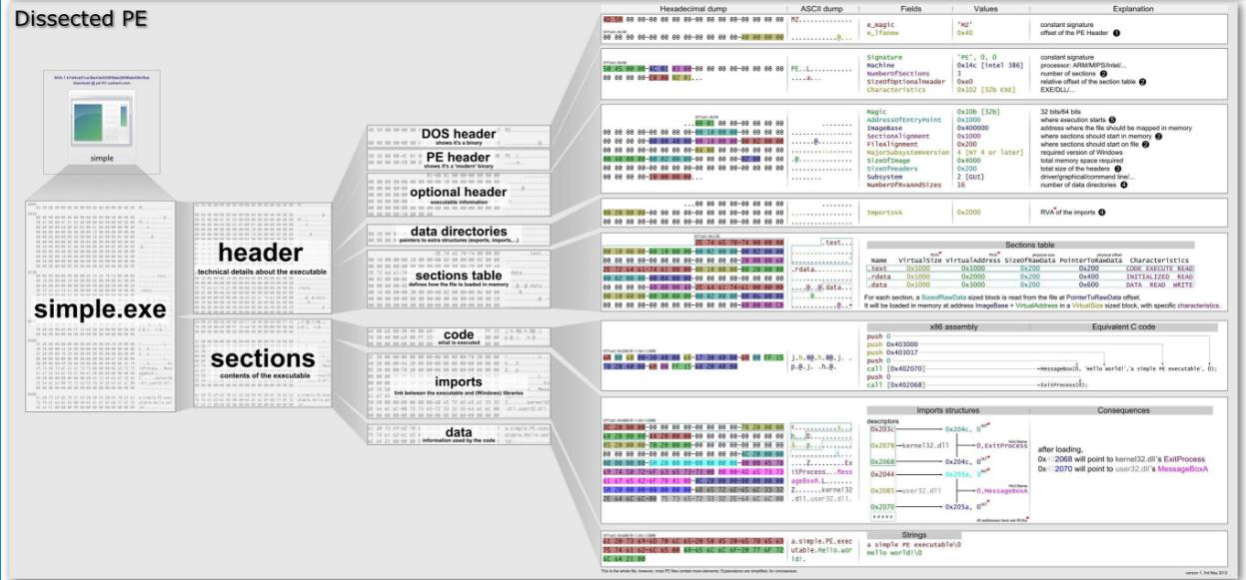

Slide 8
Static malware anaysis
API calls analysis
Header information
Section information
Imported functions
Exported functions
String information
Opcode sequences
General characteristics
General file information
Byte histogram & Entropy

Slide 9
Malware datasets
Collected from
Virustotal ^{[3]}
Virusshare ^{[4]}
MalShare ^{[5]}
Total : 398405

Slide 10
Baseline model - LSH+KNN
Locality-Sensitive Hashing (LSH) is an algorithmic technique that hashes similar input items into the same "buckets" with high probability. The technique can be seen as a way to reduce the dimensionality of high-dimensional data.
k-nearest neighbors algorithm (k-NN) classified by a plurality vote of its neighbors, with the object being assigned to the class most common among its k nearest neighbors.

Slide 11
Baseline model - EMBER ^{[2]}
Gradient Boosting Tree (lightgbm)
Features:
API calls analysis
Header information
Section information
Imported functions
Exported functions
String information
Opcode sequences
General characteristics
General file information
Byte histogram & Entropy

Slide 12
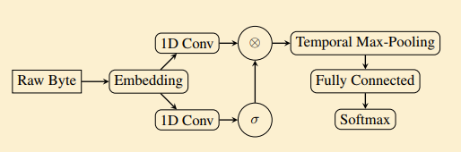
Baseline model - Malconv ^{[1]}

Slide 13
Baseline model
Methods | classiﬁcation algorithm | Features
PE header | random forest | PE header
LSH | KNN | whole file
Malconv | CNN | byte sequence
EMBER | gradient boosting tree | All

Slide 14
Graph neural network
for
malware (vulnerability) detection
& binary similarity

Slide 15
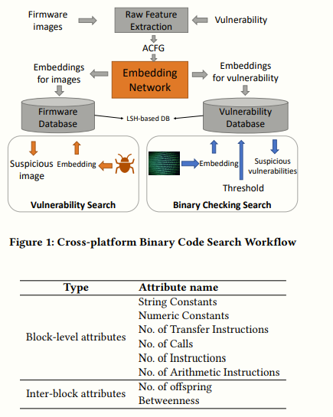
Neural network-based graph embedding for cross-platform binary code similarity detection^{[6]}

Slide 16
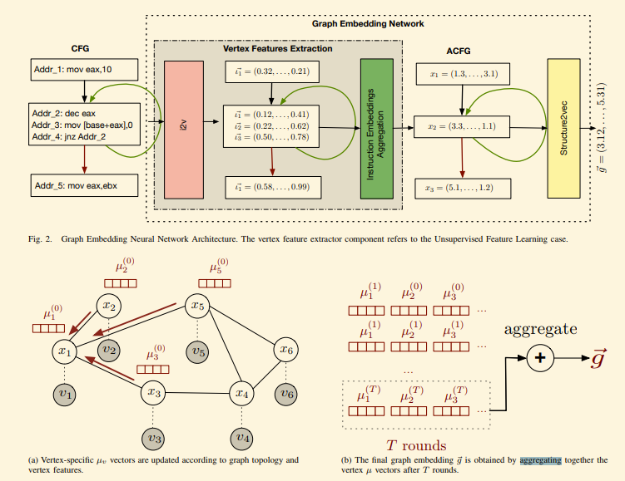
Investigating Graph Embedding Neural Networks with Unsupervised Features Extraction for Binary Analysis ^{[7]}

Slide 17
Related works
Rajeswaran, Deebiga, et al. "Function call graphs versus machine learning for malware detection." Guide to Vulnerability Analysis for Computer Networks and Systems. Springer, Cham, 2018. 259-279.
Jang, Jae-wook, et al. "Mal-netminer: Malware classification approach based on social network analysis of system call graph." Mathematical Problems in Engineering 2015 (2015).
Jiang, Haodi, Turki Turki, and Jason TL Wang. "DLGraph: Malware Detection Using Deep Learning and Graph Embedding." 2018 17th IEEE International Conference on Machine Learning and Applications (ICMLA). IEEE, 2018.
Alasmary, Hisham, et al. "Analyzing, Comparing, and Detecting Emerging Malware: A Graph-based Approach." arXiv preprint arXiv:1902.03955 (2019).
Hardy, William, et al. "DL4MD: A deep learning framework for intelligent malware detection." Proceedings of the International Conference on Data Mining (DMIN). The Steering Committee of The World Congress in Computer Science, Computer Engineering and Applied Computing (WorldComp), 2016.
Khanh-Huu-The Dam, and Tayssir Touili. "Malware Detection based on Graph Classification." ICISSP. 2017.

Slide 18
Our proposed method
Objective :
Reduce human effort
Without domain knowledge (let data do the work)
FILE in → Result out

Slide 19
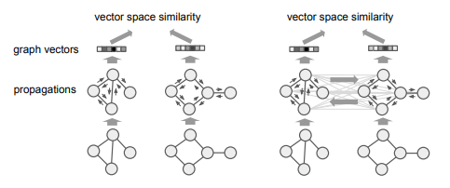
Graph Matching Networks for Learning the Similarity of Graph Structured Objects ^{[8]}

Slide 20
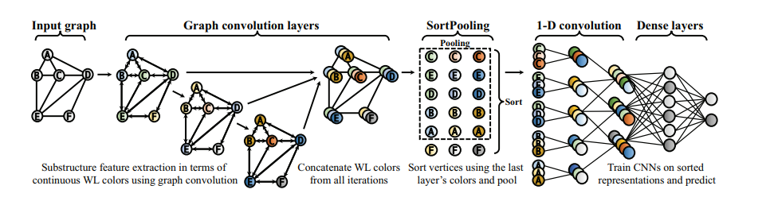
An end-to-end deep learning architecture for graph classification ^{[9]}

Slide 21
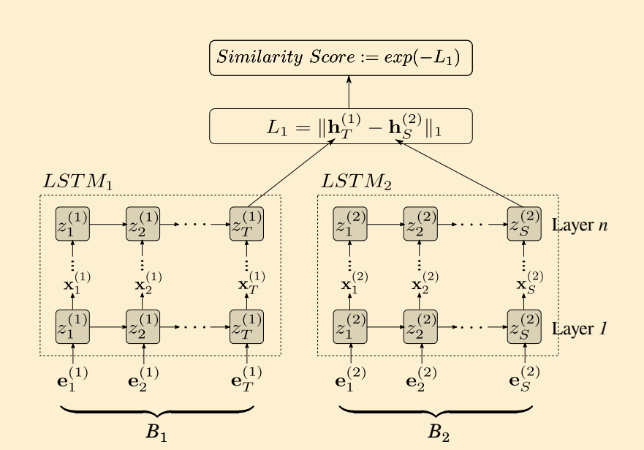
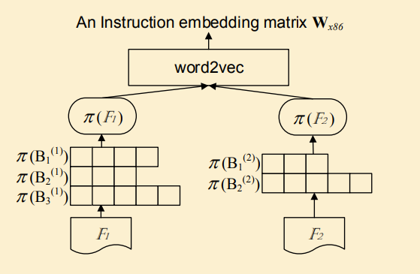
Neural machine translation inspired binary code similarity comparison beyond function pairs ^{[10]}

Slide 22
Evaluation
Methods | classiﬁcation algorithm | Features | Training data | Test AUC
PE header | random forest | PE header | 36134 | 0.957
LSH | KNN | whole file | 36134 | 0.973
Malconv | CNN | byte sequence | 36134 | 0.985
EMBER | gradient boosting tree | All | 80000 | 0.991
Graph | GNN | cfg + instructions | 800 | 0.799

Slide 23
Limitation
Constructing CFG is very very slow
Process graph structure data is very very slow
Require large RAM and large GPU memory
Cannot real-time detection
Cannot scale up for massive malware detection

Slide 24
Future Work
Complete the experiments
Machine Reasoning as tools to help human Analyst
End-to-end approach for Malware adversarial sample crafting

Slide 25
Demo

Slide 26
Reference
Raff, Edward, et al. "Malware detection by eating a whole exe." Workshops at the Thirty-Second AAAI Conference on Artificial Intelligence. 2018.
Anderson, Hyrum S., and Phil Roth. "Ember: an open dataset for training static PE malware machine learning models." arXiv preprint arXiv:1804.04637 (2018).
V. Total, “VirusTotal-Free online virus, malware and URL scanner,” https://www.virustotal.com.
Roberts, J.: VirusShare.com. http://virusshare.com/ (2015)
Malshare, https://malshare.com/
Xu, Xiaojun, et al. "Neural network-based graph embedding for cross-platform binary code similarity detection." Proceedings of the 2017 ACM SIGSAC Conference on Computer and Communications Security. ACM, 2017.
Massarelli, Luca, et al. "Investigating Graph Embedding Neural Networks with Unsupervised Features Extraction for Binary Analysis." (2016).
Li, Yujia, et al. "Graph Matching Networks for Learning the Similarity of Graph Structured Objects." arXiv preprint arXiv:1904.12787 (2019).
Zhang, Muhan, et al. "An end-to-end deep learning architecture for graph classification." Thirty-Second AAAI Conference on Artificial Intelligence. 2018.
Zuo, Fei, et al. "Neural machine translation inspired binary code similarity comparison beyond function pairs." arXiv preprint arXiv:1808.04706 (2018).
Notes:
Malconv
EMBER
Virustotal
Virusshare
Malshare

